Slide 1

IMDb Movie Analysis trainity Project#5
By:
Anurag Changmai
Data Analytics Trainee

Slide 2
Project Description
The Internet Movie Database (IMDb) is one of the world’s largest online databases for movies, television shows, podcasts, etc. It contains almost everything a user would want to know about almost any film or show made in the world. It also allows users to review and rank these films and shows, which are considered a benchmark in ratings and are quite influential for movie watchers.
In this project, I analyze a sample dataset of movies from IMDb and obtain insights that could be helpful for prospective movie watchers and critics alike. In the process, I explore the data from a financial as well as a moviegoer perspective and try to understand viewer preferences over the years.

Slide 3
Approach
This project begins by first obtaining a sample dataset of movies from IMDb. This dataset carries information for over 3800 movies, with parameters such as movie name, director name, lead actor name, budget, revenue, IMDb score, etc.
This data is then cleaned before being used, and outliers are noted to ensure all data points are taken into consideration. For better clarity, data is represented in a tabular form and a chart form wherever possible.

Slide 4
Tech-stack used
In the execution of this project, the following software was used:
1. Microsoft Excel 2019 v2306
→ It was used to understand the data, which was in XLSX format, clean it, filter it, obtain results from it, and display the same in tabular and chart forms.
2. Microsoft Excel 365 v16.0.16711.42306
→ It was used to perform calculations and run formulas that were not supported on the desktop app (MS Excel 2019 v2306)

Slide 5
Insights
Over the next few slides, I will try to obtain insights on:
1. Movies that made the highest profits
2. Top 250 movies on IMDb – overall and non-English language
3. Best directors
4. Most popular genres
5. Critic-favorite and audience-favourite actors

Slide 6
Cleaning the data
Before diving into the data to obtain insights, I had to clean the data and make it ready for analysis. The following steps were performed during the data-cleaning process:
1. The following columns were removed from the sample dataset as they did not bear significance in our analysis process and desired output:
color, director_facebook_likes, actor_3_facebook_likes, actor_2_facebook_likes, actor_1_facebook_likes, actor_2_name, actor_3_name, cast_total_facebook_likes, facenumber_in_poster, plot_keywords, movie_imdb_link, content_rating, aspect_ratio, movie_facebook_likes
2. Null values/empty cells (if any) were removed by deleting the entire row
3. Removed all duplicate values

Slide 7
Cleaning the data (Cont.)
4. Removed all 'Â ' values at the end of each value in movie_title using Find and Replace on the column
5. Replaced all mistaken accent characters using Find and Replace as follows:
Ã¨ → è, Ã© → é, Ã¡ → á, Ã­ → í, Ã§ → ç, Ã« → ë, Ã¥ → å, Ã± → ñ, Ã¦ → æ, Ã¸ → Ø, Ã¼ → ü,
Ã¶ → ö, Ã³ → ó, Ã¯ → ï, Ã… → Å, Ãº → ú, Ã‰ → É, Ã¤ → ä, Ã” → Ō, Ã° → ð, Ã(CHAR 160) → Á,
Ã» → û, Ã → à, Ã˜ → Ø, Ã´ → ô, Ã“ → Ó, Ã† → Æ
6. I also created new columns for the gross and budget data, where I divided the values by 1,000,000 to bring them to a more manageable form and present the data in millions, rounded off to 2 digits.
Now that I have cleaned the data, let’s dive into the insights.

Slide 8
1. Movies with the highest profit
To find the movies that earned the highest profits, I subtracted the gross values from the movie budget values. For ease of understanding and representation, I had already modified the values to show data in millions rather than absolute values.
The formula for obtaining the profit values is:
=ROUND((O2—P2),2)
By using the ROUND function over and above the simple subtraction, I rounded off the final values to 2 decimal places, which helps in clarity. The output is shown in the next few slides.

Slide 9
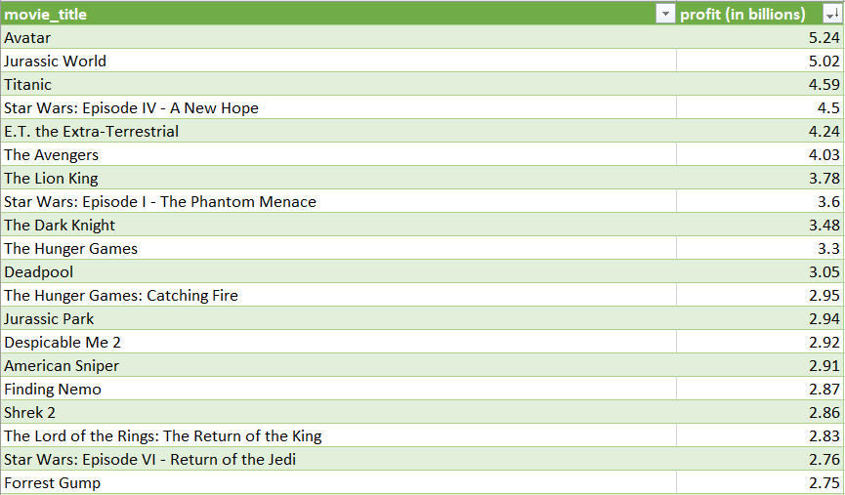
1. Movies with the highest profit (Cont.)
The table on the right shows the top 20 movies that have earned the highest profits, and their profits in billions of dollars.
The entire list of profit-making movies can be found in the final dataset, provided at the end of this slide set.

Slide 10
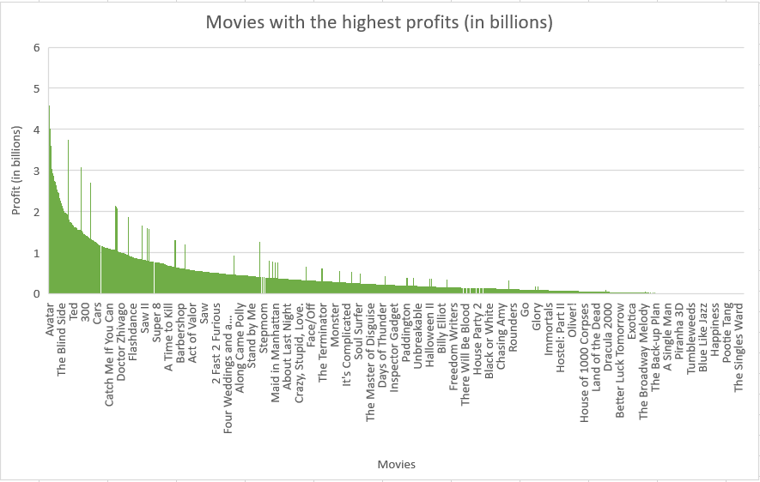
1. Movies with the highest profit (Cont.)
The histogram on the right shows the profit variation among movies that have earned the highest profits.
Please refer to the final dataset for more information.

Slide 11
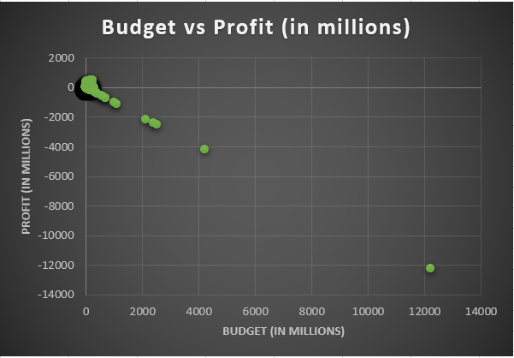
1. Movies with the highest profit (Cont.)
While analyzing the budget versus profit data for the movies, I saw outliers, specifically in the loss-making section. These outliers have been shown in the scatter plot on the right to show the scope of my dataset.
Please refer to the final dataset for more information.

Slide 12
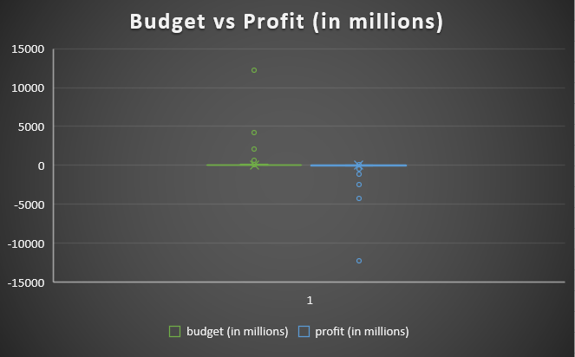
1. Movies with the highest profit (Cont.)
The outliers, as presented in the previous slide, are shown here with the help of a box-and-whisker plot.
In both plots, the outliers are on the loss-making end, at -12213.3, -4199.79, and -2499.8 in thousands of dollars.

Slide 13
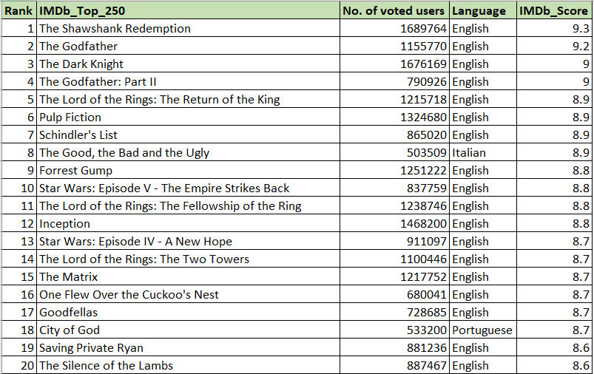
2. IMDb Top 250
To find the top 250 movies on IMDb, I used the IMDb scores of the movies as the reference. Consequently, I sorted all the movies based on their IMDb scores in descending order.
The table on the right shows a section of the top 250 movies on IMDb, based on their IMDb scores and irrespective of their languages.
Please refer to the final dataset for more information beyond the top 20 movies shown here.

Slide 14
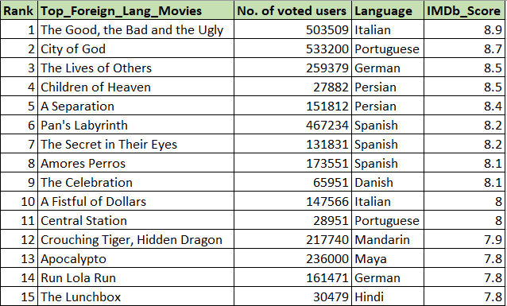
2. IMDb Top 250 (Cont.)
The table on the right shows the non-English movies that have found a place in the list of top 250 movies on IMDb, based on their IMDb scores.
To filter these results out, I used Excel 365 to run the FILTER function as:
=FILTER(B2:B251,D2:D251<>"English")
This yielded 15 foreign language movies out of the top 250.

Slide 15
3. Best directors
To arrive at the list of best directors, I created a pivot table. For this, I entered the names from the director_name column in the Rows section and the imdb_score column in the Values section. Then, I modified the Values section to show the mean of the IMDb scores instead of the default sum of the IMDb scores.
By doing this, I found the mean IMDb scores of the directors and their respective movies. Next, I sorted the table in descending order with respect to the mean IMDb scores and found the top 10 directors from the modified table.

Slide 16
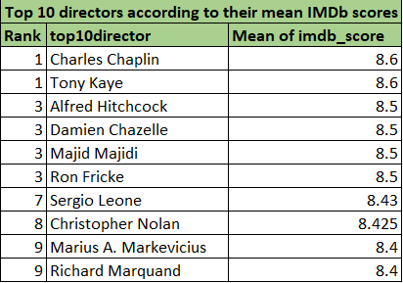
3. Best directors (Cont.)
The table on the right shows the top 10 directors, based on the mean values of the IMDb scores of their movies.
Please refer to the final dataset for more information.

Slide 17
4. Most popular genres
Similar to the previous insight, I created a pivot table for this as well. I entered the various values from the genres column in the Rows section as well as in the Values section. Then, I modified the Values section to show the count of the genres.
By doing this, I found the genre with the most movies. I sorted this table with respect to the count of genres to find the most popular genre, courtesy of the number of movies made that come under those genres.

Slide 18
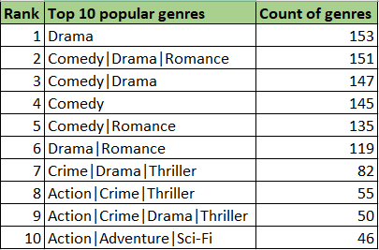
4. Most popular genres (Cont.)
The table on the right shows the top 10 most popular genres based on the number of movies made that belong to these genres.
Please refer to the final dataset for more information beyond the top 10 genres shown here.

Slide 19
5. Critic-favourite and audience-favourite actors
Identifying actors that are favourites of both critics and audiences alike from more than 3800 movies in my dataset would probably be impractical. Hence, I selected 3 names (Meryl Streep, Leonardo DiCaprio, Brad Pitt) from the list of lead actors to obtain my insights.
To determine how many people regarded either of these 3 actors as their favourite, I selected the number of critics and audiences who reviewed their movies as the measure.
Then, I created two pivot tables, with the actor names in the Rows section. For the Values section, I selected the sum, count, and mean of the number of critics and the number of users/viewers who reviewed the movies of these 3 actors. I also plot the thus obtained information using column graphs.
The data is presented in the next few slides.

Slide 20
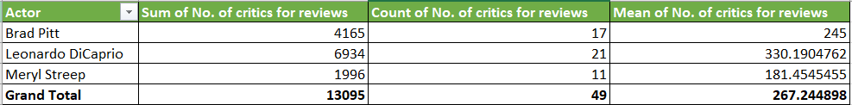
5. Critic-favourite actors
The table above shows the statistics for each of the 3 actors among critics who reviewed their movies. From the data, it can be observed that Leonardo DiCaprio is the favourite among critics.

Slide 21
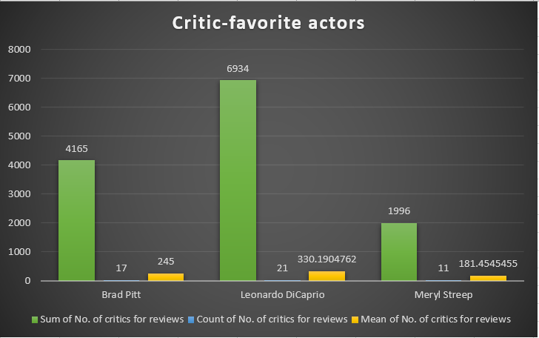
5. Critic-favourite actors (Cont.)
The column graph on the right represents the data from the previous slide graphically. Leonardo DiCaprio being the critic-favourite actor is clearly seen here.

Slide 22
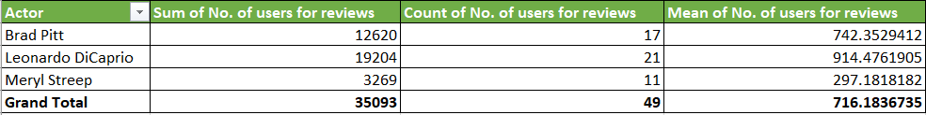
5. Audience-favourite actors
The table above shows the statistics for each of the 3 actors among users/audiences who reviewed their movies. From the data, it can be observed that Leonardo DiCaprio is the favourite among users/audiences.

Slide 23
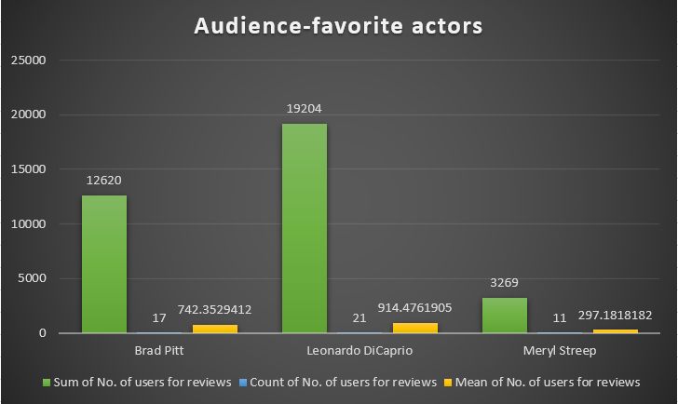
5. Audience-favourite actors (Cont.)
The column graph on the right represents the data from the previous slide graphically. Leonardo DiCaprio being the audience-favourite actor is clearly seen here.

Slide 24
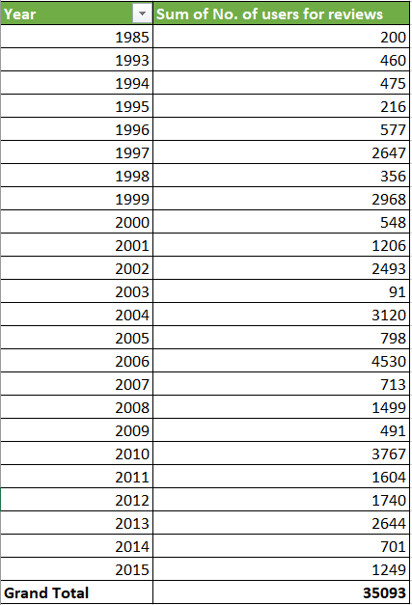
Insights on voting behaviour
The table on the right shows the number of users over the years who voted/reviewed the movies of the 3 actors previously referred to (Meryl Streep, Leonardo DiCaprio, Brad Pitt).
This was obtained by creating a pivot table with years in the Rows section and the sum of user reviews in the Values section.
It was observed that more users voted/reviewed movies during the 2000s than in any other decade.

Slide 25
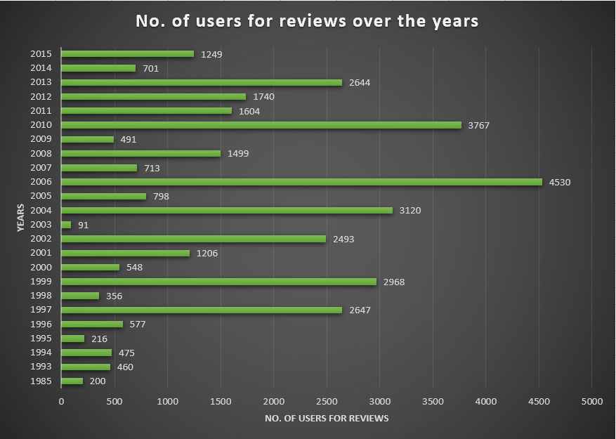
Insights on voting behaviour (Cont.)
The data from the previous slide has been represented here graphically with the help of a bar graph.

Slide 26
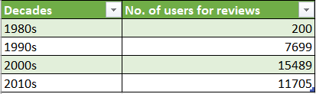
Insights on voting behaviour (Cont.)
The table on the right shows the data from the previous 2 slides by partitioning the years into their decades. It can be seen that the 2000s saw the most user votes/reviews for movies of the 3 actors.
This was obtained by identifying the decades and then applying the function:
=SUMIFS(B41:B64,A41:A64,">=1980",A41:A64,"<1990")
and so on for different years and decades.

Slide 27
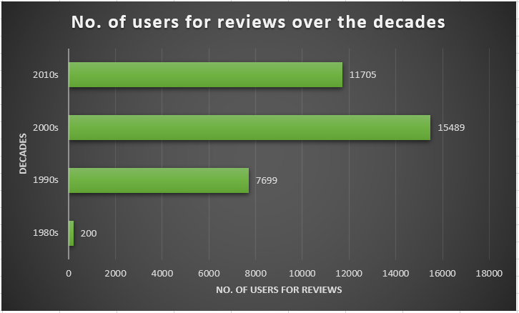
Insights on voting behaviour (Cont.)
The data from the previous slide has been represented here graphically with the help of a bar graph.

Slide 28
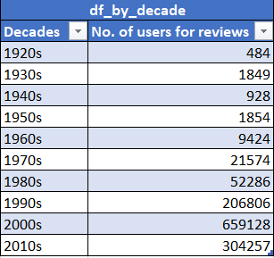
Insights on voting behaviour (Cont.)
The previous slides presented data on voting behaviour specifically for movies of the 3 actors. But how have audiences generally voted for movies from different years?
To answer this question, I took all the user reviews from all the movies over the years and partitioned them into their decades to obtain the table on the right.

Slide 29
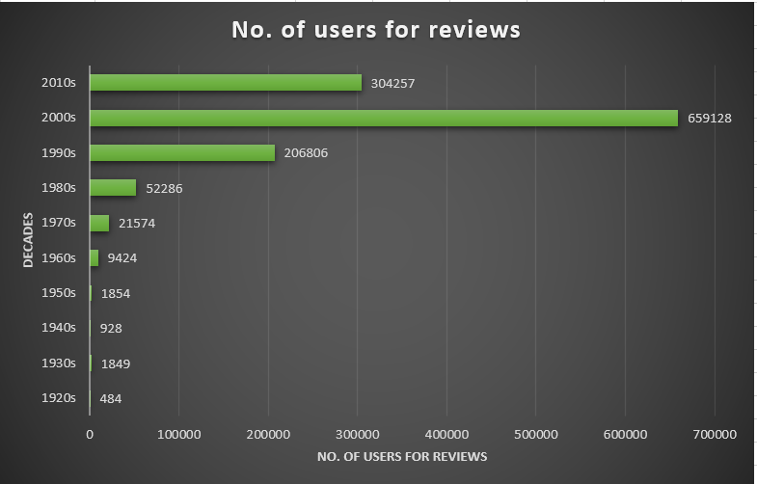
Insights on voting behaviour (Cont.)
I saw that audience votes/reviews for movies from different years did not display a specific pattern. While there was an increase in numbers from movies in the 1950s to those in the 2000s, which was the highest, it again reduced for those in the 2010s.
This can be clearly seen in the bar graph on the right.

Slide 30
Result
Based on the insights obtained from the dataset, it can be seen that:
1. Movies from the 1990s and 2000s have made the most profit. They also rank highly on IMDb scores and find mention in the Top 250 movies.
2. The decline in the number of profit-making movies in the 2010s, along with the reduction in the number of audiences voting/reviewing them, could perhaps be attributed to the economic meltdown of 2008, following which moviegoers might have reduced the number of movies they watched in theatres.
3. The latter part of the 2010s saw an increase in profit-making movies and consequently, the number of votes/reviews, marking an improvement in economic standards across countries.

Slide 31
Result (Cont.)
4. The comedy genre features in 4 of the top 5 genres, reflecting the mood and requirements of audiences over the years, regardless of periods of turmoil.
5. The directors with high IMDb scores are spread across decades, implying that regardless of the years, good art is always appreciated.
This project has immensely helped me in understanding and applying advanced concepts of Microsoft Excel, along with data visualization techniques. It also provided a window into movie watchers and their preferences, which could be helpful in deciding storylines for future movies.
The complete dataset can be found here:

